Slide 1


Slide 2

Parameter-Efficient Fine-Tuning of LLaMA 3.1 for Arabic Legal Question Answering: A Case Study on Jordanian Laws
Mohammed Fasha, Bassam Hammo, Bilal Sowan, Husam Barham, Esam Al-Nsour

Slide 3
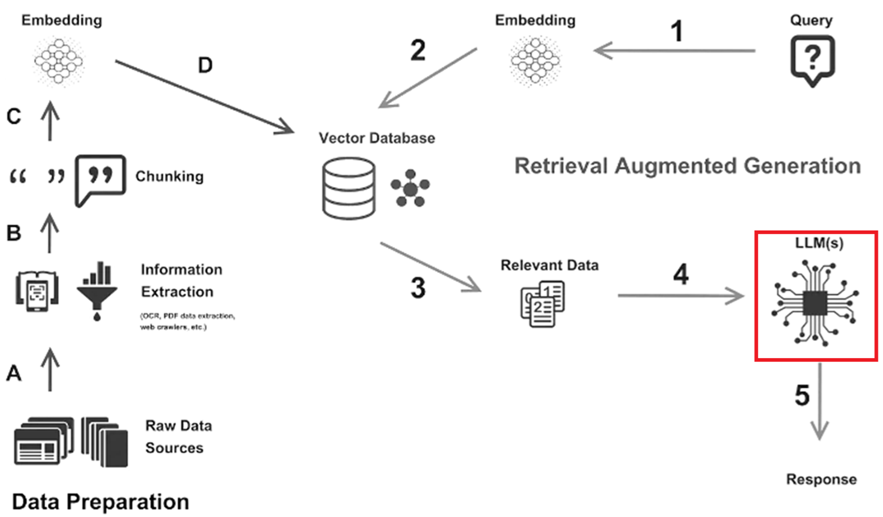
Research Objectives
Lay groundwork for integrating Arabic Legal-Aware LLMs into Retrieval-Augmented Generation (RAG) systems
Challenges:
Complex legal language and structures
Scarcity of annotated Arabic legal datasets
Need for models that can understand and reason over Arabic legal texts
Opportunity:
Leveraging advanced LLMs like LLaMA 3.1 with PEFT to address these challenges
Employing PEFT techniques (LoRA with 4-bit quantization) for efficient training
Leverage Foundation LLMs, such as OpenAI GPT models, to address the scarcity of Arabic datasets
Standard RAG Architecture

Slide 4
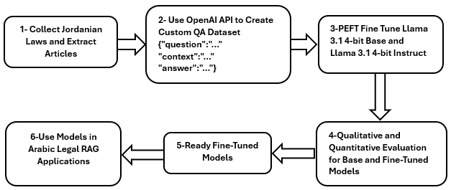
Methodology

Slide 5
1. Data Collection & Preparation
# | Selected Jordanian Laws
1 | Jordanian Civil Law القانون المدني الأردني
2 | Electronic Crimes Law 2024 قانون الجرائم الإلكترونية 2024
3 | Jordanian Labor Law with Full Amendments قانون العمل الأردني مع كامل التعديلات
4 | Narcotics and Psychotropic Substances Law قانون المخدرات والمؤثرات العقلية
5 | Principles of Criminal Court Law قانون أصول المحاكمات الجزائية
6 | Principles of Civil Court Procedures Law قانون أصول المحاكمات المدنية
7 | Jordanian Data Law قانون البيانات الأردني
8 | Arbitration Law قانون التحكيم الأردني
9 | Jordanian Execution Law قانون التنفيذ الأردني
10 | Jordanian Economic Crimes Law قانون الجرائم الاقتصادية الأردني
11 | Jordanian Companies Law قانون الشركات الأردني
12 | Jordanian Penal Code قانون العقوبات الأردني
13 | Formation of Regular Courts Law قانون تشكيل المحاكم النظامية
14 | Law on the Protection of Copyright قانون حماية حق المؤلف
15 | Conciliation Courts Law قانون محاكم الصلح
16 | Law on the Trial of Ministers قانون محاكمة الوزراء
17 | Bar Association Law, including regulations for agents قانون ونظام وتعليمات نقابة المحامين والوكلاء
18 | Law, Regulation, and Instructions for Commercial Agents and Brokers قانون ونظام وتعليمات الوكلاء والوسطاء التجاريين
Source: Collected 18 Jordanian legal documents, encompassing a total of 3,578 articles.
Preprocessed Text to Enable Generating (Question, Answer, Context) triples.

Slide 6
1. Data Collection & Preparation
# | Selected Jordanian Laws
1 | Jordanian Civil Law القانون المدني الأردني
2 | Electronic Crimes Law 2024 قانون الجرائم الإلكترونية 2024
3 | Jordanian Labor Law with Full Amendments قانون العمل الأردني مع كامل التعديلات
4 | Narcotics and Psychotropic Substances Law قانون المخدرات والمؤثرات العقلية
5 | Principles of Criminal Court Law قانون أصول المحاكمات الجزائية
6 | Principles of Civil Court Procedures Law قانون أصول المحاكمات المدنية
7 | Jordanian Data Law قانون البيانات الأردني
8 | Arbitration Law قانون التحكيم الأردني
9 | Jordanian Execution Law قانون التنفيذ الأردني
10 | Jordanian Economic Crimes Law قانون الجرائم الاقتصادية الأردني
11 | Jordanian Companies Law قانون الشركات الأردني
12 | Jordanian Penal Code قانون العقوبات الأردني
13 | Formation of Regular Courts Law قانون تشكيل المحاكم النظامية
14 | Law on the Protection of Copyright قانون حماية حق المؤلف
15 | Conciliation Courts Law قانون محاكم الصلح
16 | Law on the Trial of Ministers قانون محاكمة الوزراء
17 | Bar Association Law, including regulations for agents قانون ونظام وتعليمات نقابة المحامين والوكلاء
18 | Law, Regulation, and Instructions for Commercial Agents and Brokers قانون ونظام وتعليمات الوكلاء والوسطاء التجاريين
Dataset Creation:
  QAC Triples Generation: Utilized OpenAI's GPT-3.5 Turbo to generate approximately 6,000 (Question, Answer, Context) triples.
  Manual Review: Each QA pair was manually reviewed to ensure accuracy and relevance to the legal context.
{ "id": 3,
"question": "ما هي الشروط المطلوبة للاعتماد على العرف كمصدر للحكم في حال عدم وجود نصوص قانونية؟",
"context": "المادة 2\nتسري نصوص هذا القانون على المسائل التي تتناولها هذه النصوص بألفاظها ومعانيها ولا مساغ للاجتهاد في مورد النص .2. فاذا لم تجد المحكمة نصاً في هذا القانون حكمت [في الفقه الإسلامي الأكثر موافقة لنصوص هذا القانون ، فان لم توجد فبمقتضى مبادئ الشريعة الإسلامية .3. فان لم توجد حكمت بمقتضى العرف ، فان لم توجد حكمت بمقتضى قواعد العدالة ، ويشترط في العرف أن يكون عاما وقديما ثابتا ومطردا ولا يتعارض مع أحكام القانون أو النظام العام أو الآداب . أما اذا كان العرف خاصا ببلد معين فيسري حكمه على ذلك البلد .4. ويسترشد في ذلك كله بما اقره القضاء والفقه على أن لا يتعارض مع ما ذكر .",
"answer": "يجب أن يكون العرف عاما وقديما ثابتا ومطردا وألا يتعارض مع أحكام القانون أو النظام العام."
}, {"id": 4,
"question": "ما الأساس الذي يستند إليه القضاء والفقه في اتخاذ القرارات القانونية؟",
"context": "المادة 2\nتسري نصوص هذا القانون على المسائل التي تتناولها هذه النصوص بألفاظها ومعانيها ولا مساغ للاجتهاد في مورد النص .2. فاذا لم تجد المحكمة نصاً في هذا القانون حكمت [في الفقه الإسلامي الأكثر موافقة لنصوص هذا القانون ، فان لم توجد فبمقتضى مبادئ الشريعة الإسلامية .3. فان لم توجد حكمت بمقتضى العرف ، فان لم توجد حكمت بمقتضى قواعد العدالة ، ويشترط في العرف أن يكون عاما وقديما ثابتا ومطردا ولا يتعارض مع أحكام القانون أو النظام العام أو الآداب . أما اذا كان العرف خاصا ببلد معين فيسري حكمه على ذلك البلد .4. ويسترشد في ذلك كله بما اقره القضاء والفقه على أن لا يتعارض مع ما ذكر .",
"answer": "يستند القضاء والفقه في اتخاذ القرارات القانونية إلى عدم التعارض مع الأحكام المذكورة." }

Slide 7
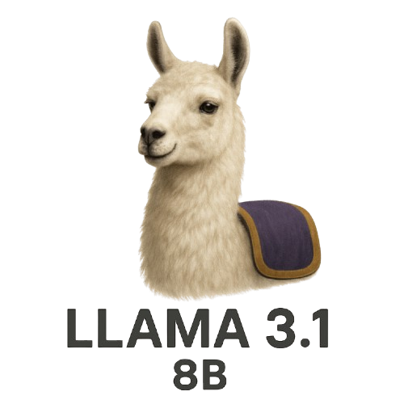
2. Models Selection - LLaMA and LLaMA 3.1 Models
LLaMA
November 30, 2022, OpenAI launched ChatGPT to the public.
February 24, 2023, Meta introduced Llama 1.
LLaMA (Large Language Model Meta AI) is a series of open-source large language models developed by Meta AI.
Designed for versatility, these models are capable of tasks ranging from text generation to complex reasoning.
LLaMA 3.1
Released in July 2024, LLaMA 3.1 includes models with 8B, 70B, and 405B parameters.
The 8B variant is particularly suited for fine-tuning on specific tasks due to its balance between performance and computational efficiency.
Key Features
  Enhanced performance in multilingual tasks.
  Improved reasoning capabilities.
  Open-source availability, facilitating customization and deployment.
https://ai.meta.com/blog/meta-llama-3-1/

Slide 8
2. Models Selection - LLaMA and LLaMA 3.1 Models
We Selected the following Base Models in our work:
  Meta-Llama-3.1-8B
  Meta-Llama-3.1-8B-Instruct
https://ai.meta.com/blog/meta-llama-3-1/

Slide 9
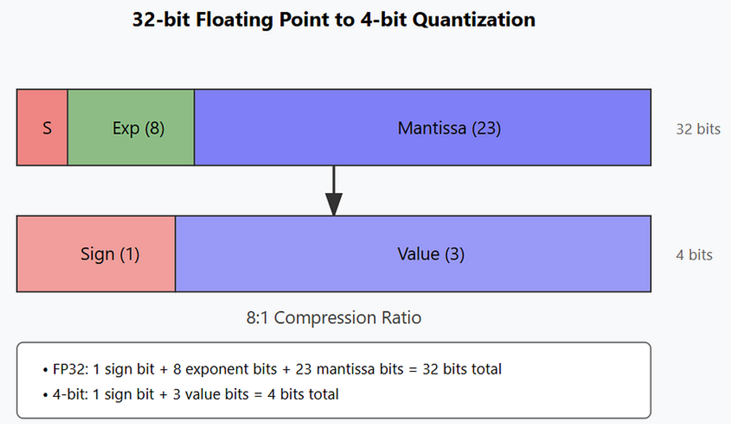
Quantization in LLMs
  Quantization is a technique that reduces the precision of the numbers used to represent a model's parameters, leading to smaller model sizes and faster computations.
4-bit Quantization
  Involves representing model weights using 4 bits instead of the standard 16 or 32 bits.
  This significantly reduces the model's memory footprint and accelerates inference times.
Benefits
  Reduces model size by up to 75%, enabling deployment on devices with limited resources.
    Original (FP16): Approximately 16 GB
    Quantized (4-bit): Approximately 4 GB
Inference Speed: Quantized models exhibit faster inference times due to reduced computational overhead.
Accuracy Retention: Maintains over 99% of the original model's performance, ensuring reliable outputs for legal question-answering tasks.
Resource Efficiency: Facilitates deployment in environments with constrained computational resources, such as edge devices or standard GPUs.
Implementation: Utilized the bitsandbytes library to apply 4-bit quantization to the LLaMA 3.1 8B model, facilitating efficient storage and faster inference without significant loss in performance.

Slide 10
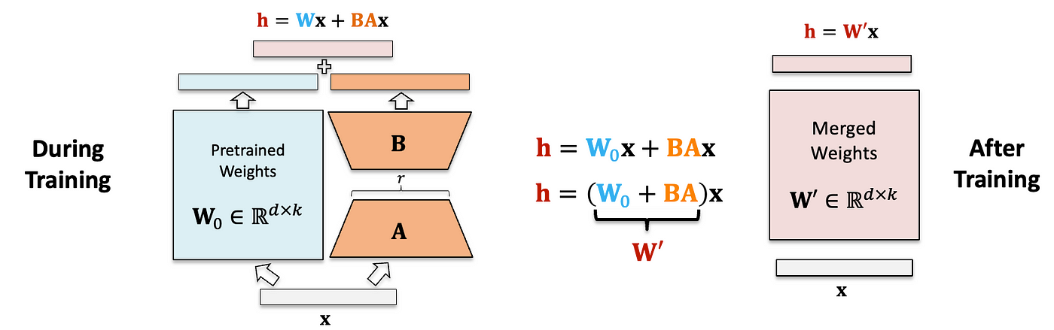
Parameter-Efficient Fine-Tuning (PEFT) and LoRA
  Parameter-Efficient Fine-Tuning (PEFT) refers to techniques that adapt pre-trained models to new tasks by updating a small subset of parameters, making the process more resource-efficient.
  LoRA is a PEFT method that adds trainable low-rank matrices to certain layers of the model.
  During fine-tuning, only these additional matrices are updated, while the original model parameters remain unchanged.
Advantages
  Significantly reduces the number of trainable parameters, leading to faster training times.
  Minimizes the risk of overfitting and preserves the pre-trained knowledge of the model.

Slide 11

3. Fine-Tuning with Unsloth & LoRA
Unsloth is an open-source framework designed to optimize and accelerate the fine-tuning of large language models (LLMs) like LLaMA.
It achieves this by implementing efficient training techniques and reducing memory usage.
Key Features
Supports 4-bit and 16-bit quantization for memory efficiency.
Utilizes manual backpropagation and custom GPU kernels for faster computation.
Compatible with various LLM architectures, including LLaMA, Mistral, and Gemma.
Benefits
Achieves up to 30x faster training speeds compared to traditional methods.
Reduces memory usage by up to 90%, enabling fine-tuning on resource-constrained hardware.
Facilitates the fine-tuning process for users with limited computational resources.

Slide 12
3. Fine-Tuning with Unsloth & LoRA
LoRA Configuration:
  Rank (r): 16
  Alpha (lora_alpha): 16
  Dropout: 0.0
  Target Modules: Applied LoRA adapters to all linear layers, including query, key, value, and output projections.
Training Parameters:
  Batch Size: 1
  Gradient Accumulation Steps: 4
  Epochs: 3
  Learning Rate: 5e-5
  Max Sequence Length: 2048 tokens
Hardware: Training implemented on Google Colab Pro with NVIDIA A100 GPU.

Slide 13
4. Evaluation
Quantitative:
  BLEU Score: Measures the overlap between the model's output and reference answers.
  ROUGE Scores: ROUGE-1, ROUGE-2, and ROUGE-L to assess recall-oriented understanding.
Qualitative:
  Manual evaluation focusing on the legal accuracy and relevance of the model's responses.
  Performance Comparison:
Model | BLEU | ROUGE-1 | ROUGE-2 | ROUGE-L | Comments
LLaMA 3.1 | 0.058 | 0.026 | 0.000 | 0.026 | Extremely poor performance without fine-tuning; unable to generate legally relevant or structurally correct outputs; near-random bigram matches.
LLaMA 3.1 Instruct | 0.128 | 0.070 | 0.013 | 0.070 | Instruction-tuned variant shows moderate improvement, suggesting some general ability to follow question prompts, but lacks domain adaptation.
Fine-tuned LLaMA 3.1 | 0.290 | 0.081 | 0.020 | 0.081 | Substantial improvement after fine-tuning; highest BLEU, ROUGE-1, and ROUGE-L scores; shows better legal understanding and context relevance.
Fine-tuned LLaMA 3.1 Instruct | 0.270 | 0.063 | 0.005 | 0.063 | Fine-tuned Instruct variant improves over its base version but underperforms compared to fine-tuned standard LLaMA 3.1, likely due to conflicting prior instruction biases.

Slide 14

Insights, Most Important Observations
Fine-tuning greatly enhances performance across all metrics, particularly BLEU and ROUGE-1, confirming that domain-specific training is crucial for legal QA tasks.
ROUGE-2 scores remain low across all models, which is consistent with expectations in open-ended, domain-specific QA. This reinforces the need for complementary manual evaluation.
Fine-tuned models show better recall (ROUGE-1 and ROUGE-L), suggesting improved coverage of key concepts in legal responses, even when exact phrasing varies.
Standard LLaMA 3.1 outperforms the Instruct variant after fine-tuning, indicating that starting from a neutral base model can sometimes be more advantageous for specialized tasks, likely because it avoids inherited biases from general instruction tuning.
Scarcity of Labeled Dataset can be effectively mitigated using GenAI, so much potentials in this area.
GitHub Repository: https://github.com/msfasha/ArabicLegalLLM

Slide 15
Thank You

Slide 16
June 2018: OpenAI releases the first generation of GPT (Generative Pre-trained Transformer), showcasing the potential of transformer-based architectures for language tasks.
February 2019: OpenAI announces GPT-2, demonstrating significantly improved text generation capabilities compared to its predecessor. Its release strategy involved a staged rollout due to concerns about potential misuse.
June 2020: OpenAI launches GPT-3, a much larger model with 175 billion parameters, exhibiting remarkable abilities in various language understanding and generation tasks. Access was initially through an API.
2021: Google announces LaMDA (Language Model for Dialogue Applications), highlighting its focus on conversational AI and its ability to engage in more natural and context-aware dialogues.
April 2022: Google introduces PaLM (Pathways Language Model), a large-scale model demonstrating advancements in reasoning, code generation, and multilingual understanding.
April 2022: DeepMind unveils Chinchilla, emphasizing the importance of training on more data for a given model size, achieving state-of-the-art performance with fewer parameters than some contemporaries.
November 30, 2022: OpenAI publicly launches ChatGPT, a conversational AI based on the GPT-3.5 architecture. Its user-friendly interface and impressive dialogue capabilities lead to widespread public attention.
February 24, 2023: Meta AI introduces Llama 1 (Large Language Model Meta AI), emphasizing open access for the research community and efficient inference.
March 2023: OpenAI releases GPT-4, the next generation of their large language model, showcasing enhanced capabilities in reasoning, creativity, and handling multimodal inputs (though initially text-only for most users).
July 2023: Meta and Microsoft announce the open-source release of Llama 2, with a focus on commercial usability and further expanding access to advanced LLM technology.
December 2023: Google launches Gemini 1.0, a multimodal model claimed to outperform previous models in various benchmarks.
February 2024: OpenAI introduces Sora, a text-to-video generative AI model, demonstrating capabilities beyond language.
April 2024: Google releases Gemini 1.5, featuring a significantly expanded context window, allowing it to process vast amounts of information.
April 2025: Various companies continue to release and refine new models and features, focusing on aspects like efficiency, multimodality, reasoning, and real-world applications. As of today, April 28, 2025, the field is still rapidly evolving with ongoing research and development.

Slide 17
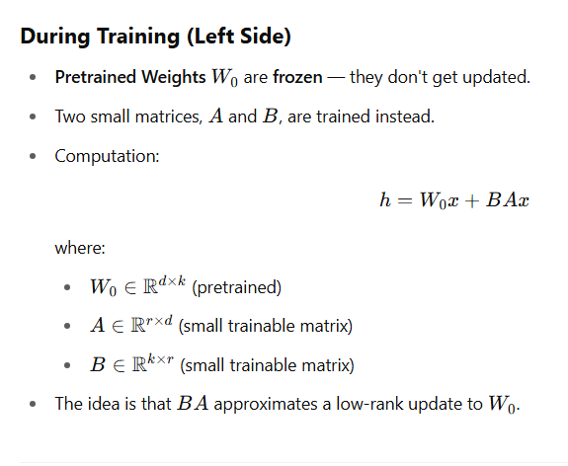
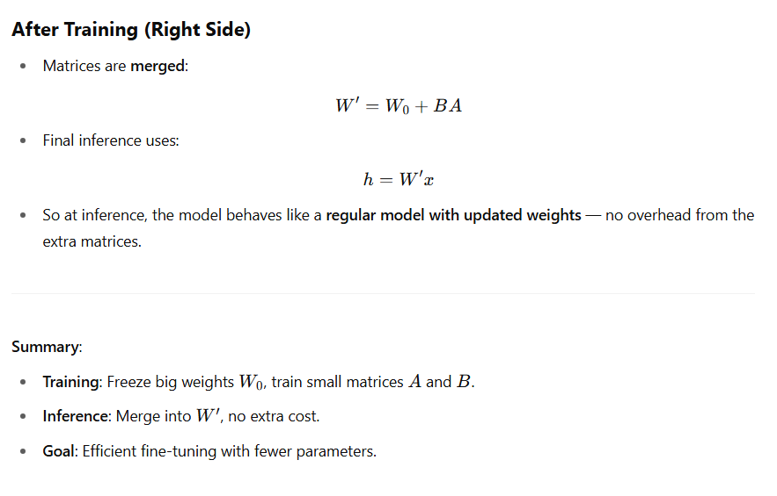
PEFT-LORA
Summary:
Training: Freeze big weights W0W_0W0​, train small matrices AAA and BBB.
Inference: Merge into W′W'W′, no extra cost.
Goal: Efficient fine-tuning with fewer parameters.

Slide 18
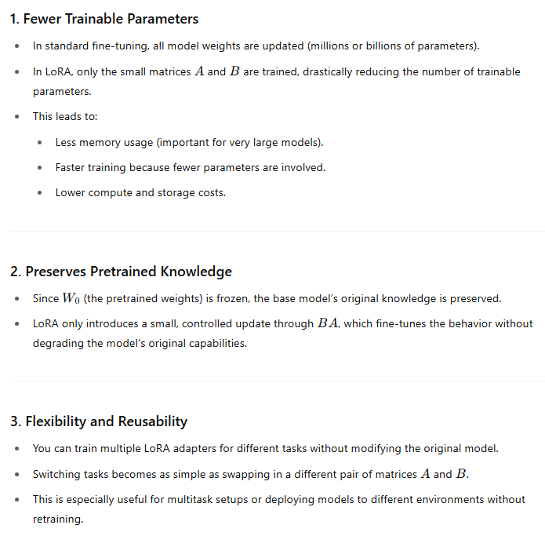
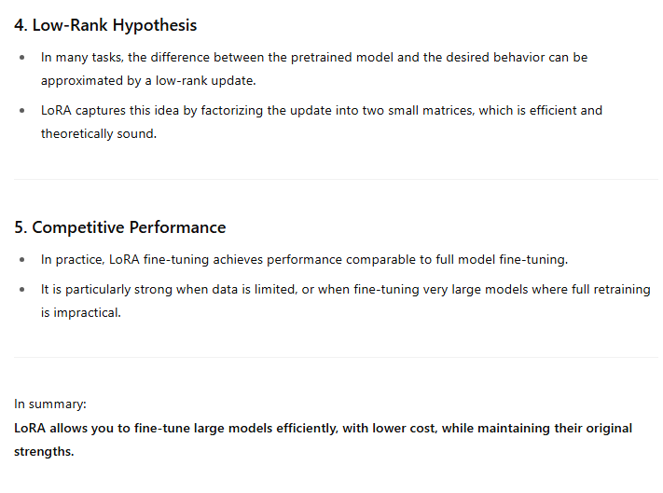

Slide 19
